Slide 1
Artificial Neural Network Number Detector
Ryan McBee, Jack Cottom,
Cheyenne Martinez, Taylor Lipson
Notes:
Ryan

Slide 2
Overview
What we did
We synthesized an ANN using ASIC design
Why would someone use this
Faster than software artificial neural network
Why is this appropriate
Optimize parallel processing
Notes:
Ryan

Slide 3
System Design

Slide 4
Overall system
Avalon Bus
Notes:
System design - Ryan

Slide 5
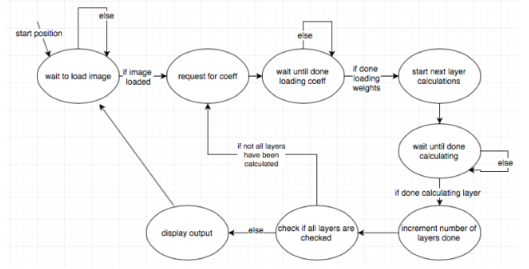
Sequence of Operation
Notes:
Ryan

Slide 6
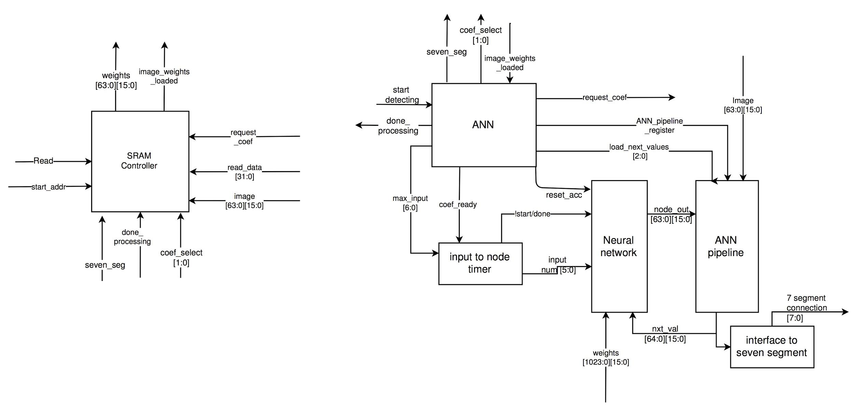
The artificial neural network
Neural
Network
Notes:
System design - Cheyenne

Slide 7
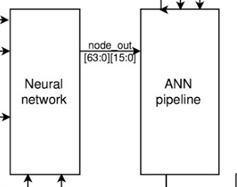
Node Interactions
Notes:
Cheyenne

Slide 8
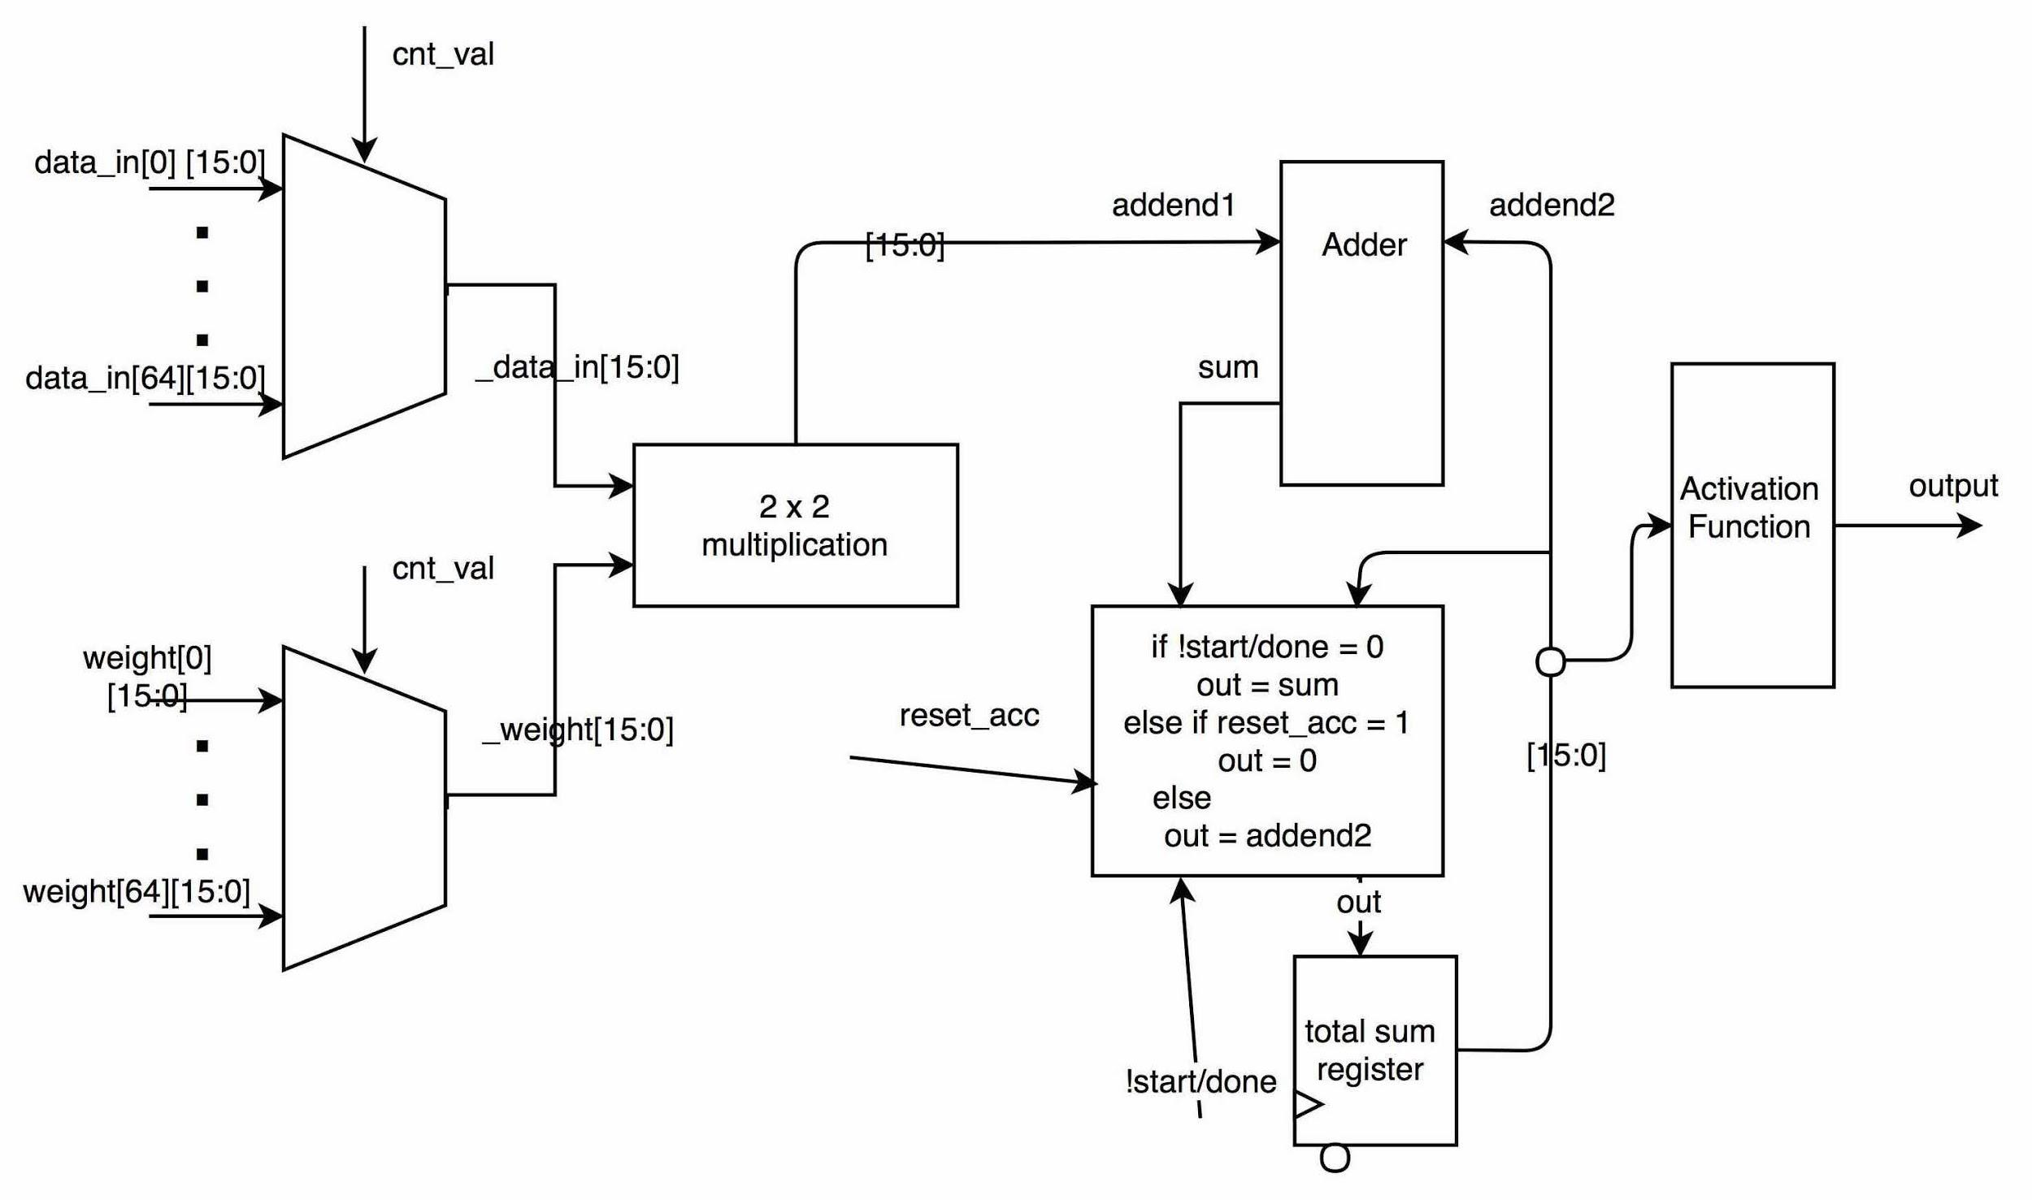
Individual node
Fixed point math
Input
select
Activation Function
Notes:
System design - Cheyenne

Slide 9
Results

Slide 10
Success Criteria Status
Create single node
Results: Able to sum all coefficients and inputs
Python ANN example
Results: Able to train and recognize images
Create non-linear activation function in verilog
Results: compiles and approximates original equation well
Notes:
Results -Taylor

Slide 11
Success Criteria Status
Get a working 4x4 image input ANN
Results: Functions like the python code
Get a working 8x8 image input ANN
Results: Functions like the python code
Put on FPGA
Results: Source/mapped compiled but unable to load onto the fpga
Notes:
Results - Taylor

Slide 12
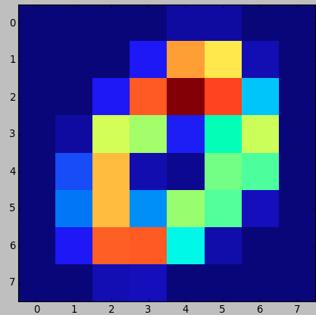
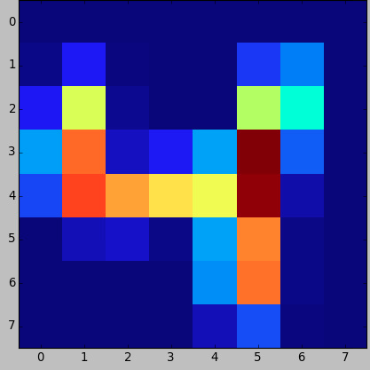
Python ANN - Training Data (DSSC-2)
MNIST data set
Number:
0
Number:
4
Notes:
Python - Taylor Dataset was originally 28x28

Slide 13
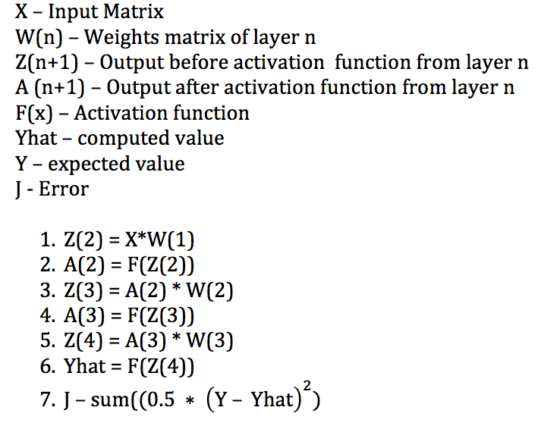
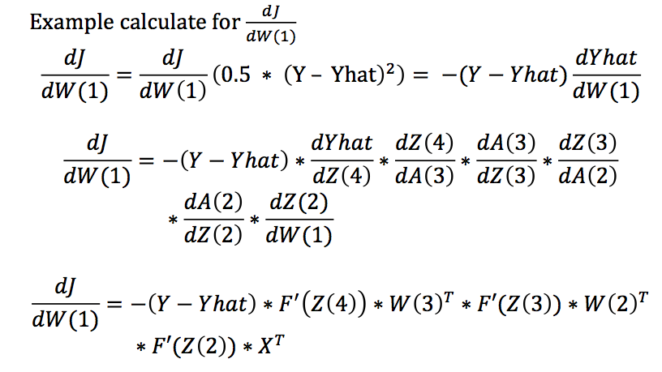
Python ANN - Back Propagation (DSSC-2)
Notes:
Python - Taylor

Slide 14
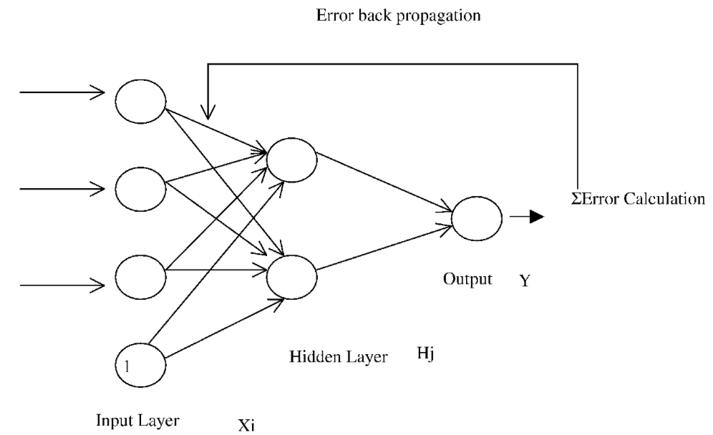
Python ANN - Back Propagation (DSSC-2)
Notes:
Python - Taylor

Slide 15
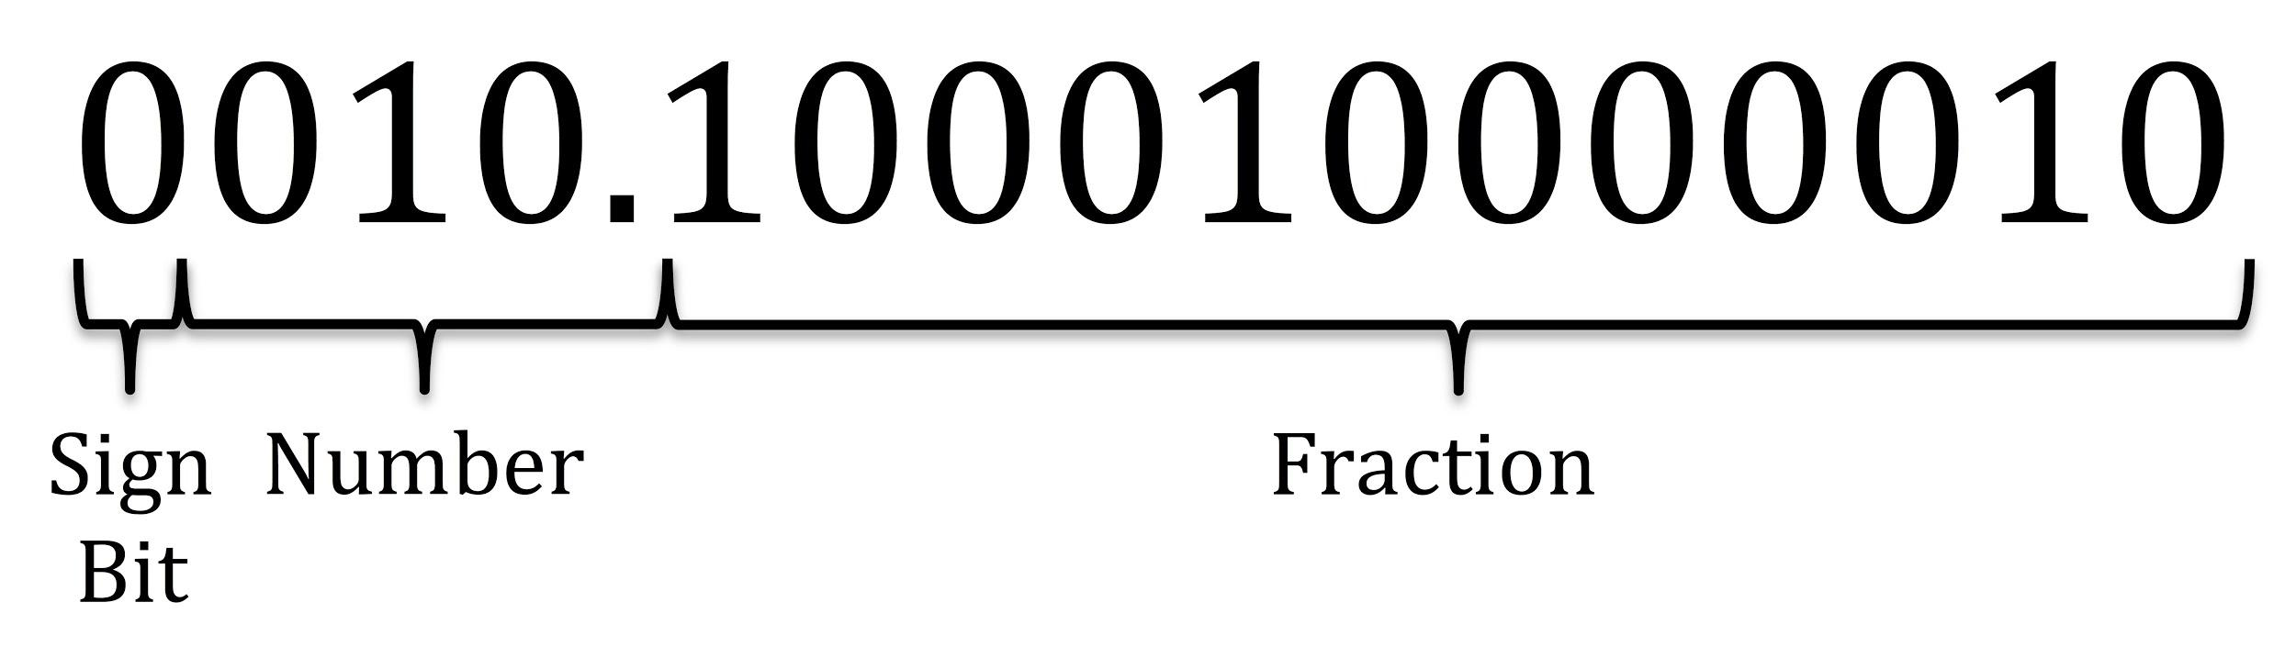
Fixed point representation
Notes:
System design - Jaaack

Slide 16
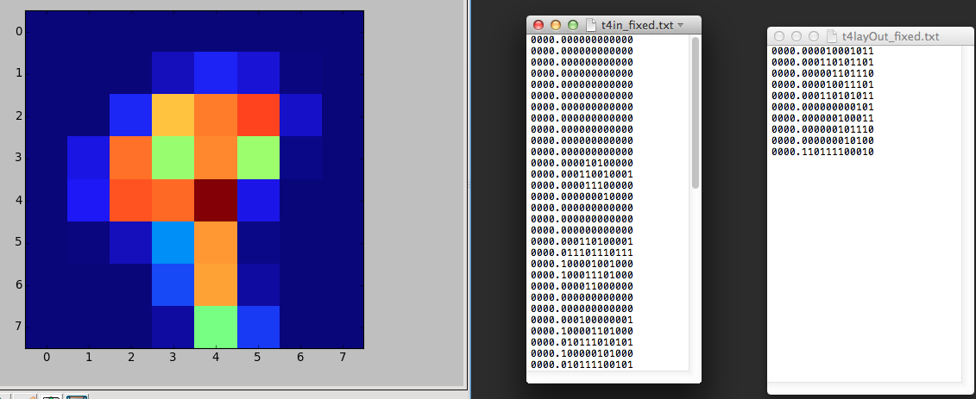
Verifying functionality of full ANN (DSSC-1,3,4,5)
Testcase Image
Input
Fixed point
Output
Fixed point
Notes:
Results -Jack

Slide 17
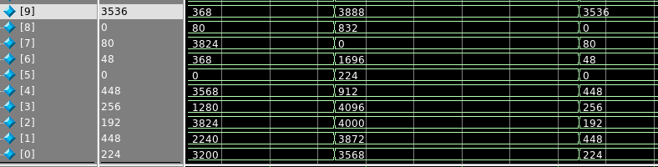
Verifying functionality of full ANN (DSSC-1,3,4,5)
First layer
Second layer
Final layer
Notes:
Results - Jack

Slide 18
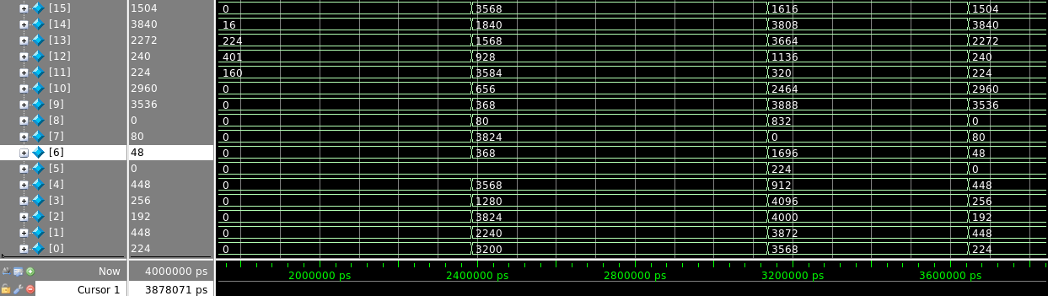

Slide 19
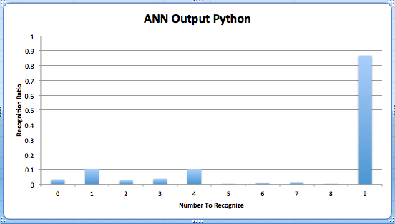
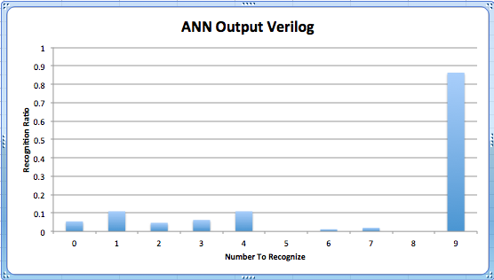
Execution Comparison (DSSC-1,3,4,5)
Notes:
Results - Jack

Slide 20
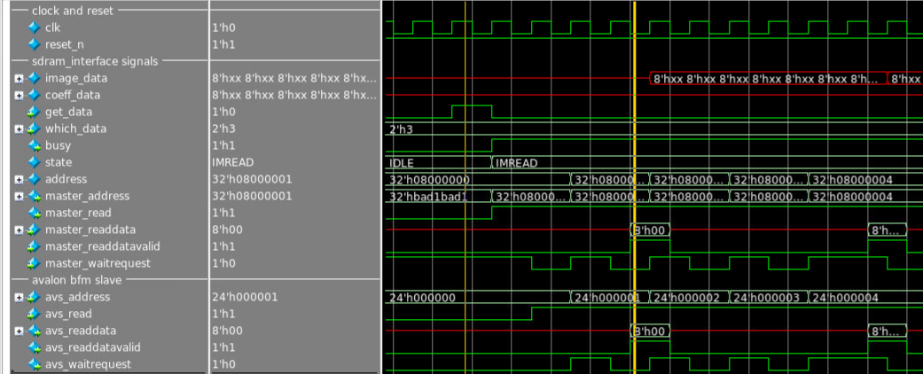
SDRAM - Avalon Interface (DSSC-6)
Input to state machine
First byte read
Notes:
results - Jack

Slide 21
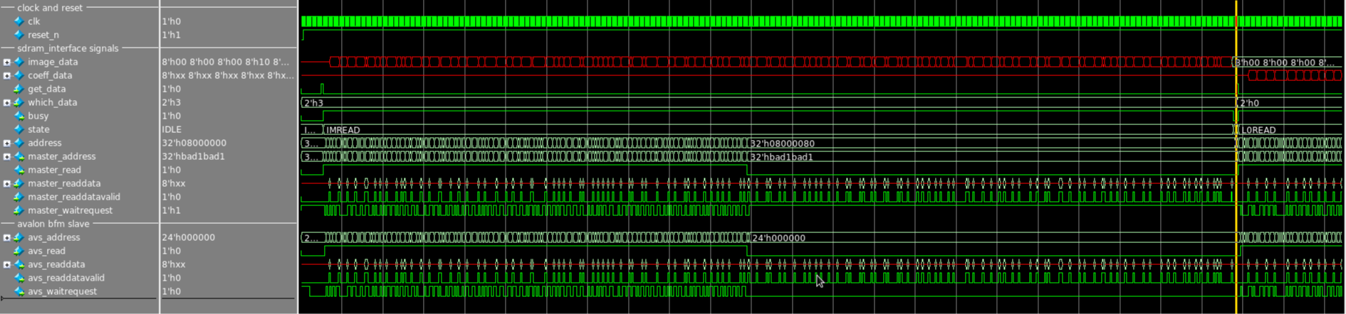
SDRAM - Pipelined Read Transactions
...
Start requests
End receive

Slide 22
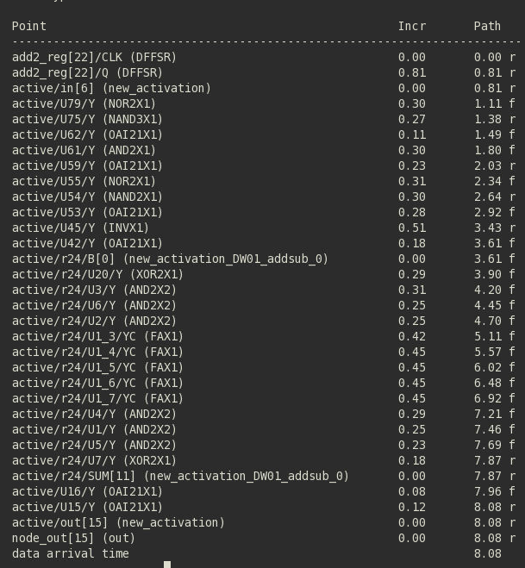
Layout
Critical path delay
Timing budget
estimated
critical path delay:
Node_data_in -> node_out
10.5 ns
Notes:
Results - Jack

Slide 23
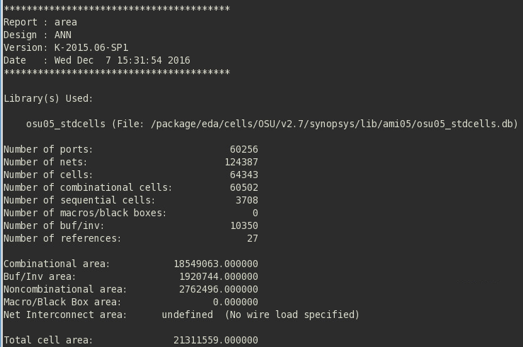
Layout
Area
Notes:
Results - Jack

Slide 24
Layout
Critical path delay
Synthesis critical delay
Timing budget estimated critical path delay
Notes:
Results - Jack

Slide 25
Conclusion
Challenges
Learning about ANNs
Fixed-point math
How we would have done it differently
Plan more in the begining with higher detail about ANNs
Improvements
Standardize math
Flexibility in hyperparameters
Notes:
Jack

Slide 26
Questions

Slide 27
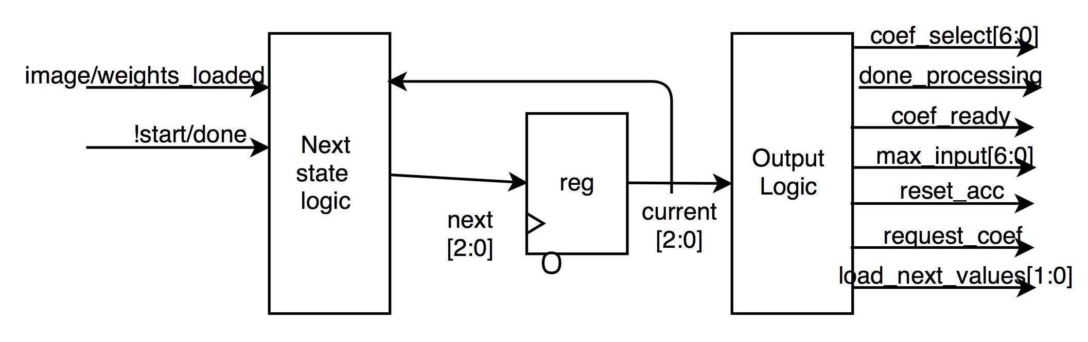
ANN controller
Notes:
System design - Ryan

Slide 28
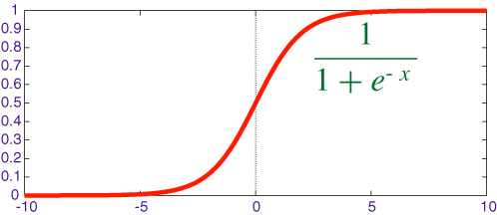
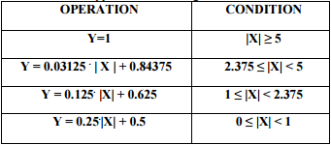
Sigmoid activation function
Sigmoid function
Notes:
System design - http://www.iosrjen.org/Papers/vol2_issue6%20%28part-1%29/N026135521356.pdf - Ryan

Slide 29
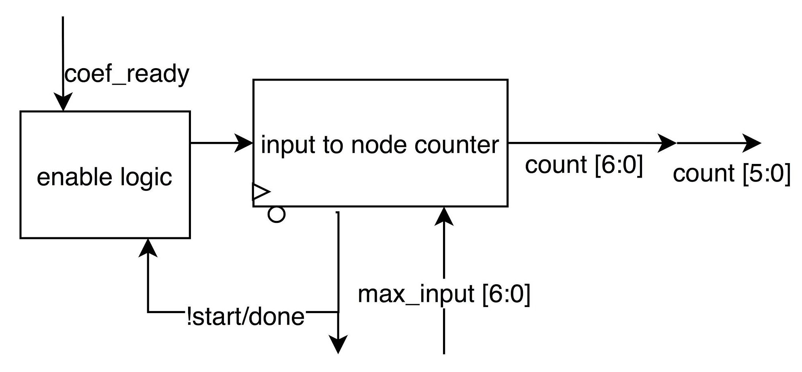
Input to node timer
Notes:
System design

Slide 30
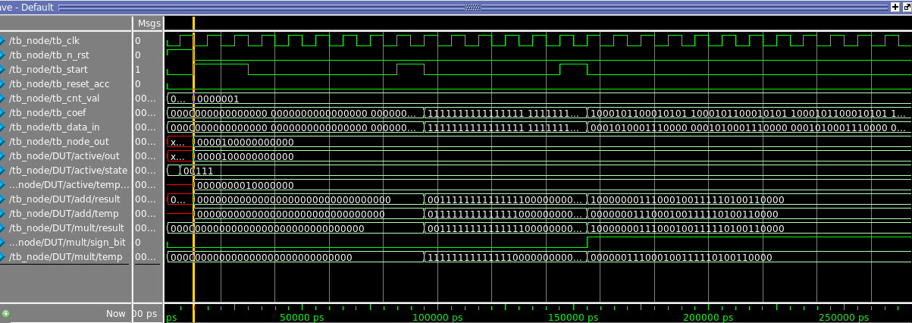
Verifying individual node operation
Notes:
Results

Slide 31
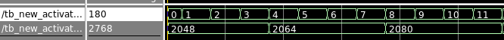
Verifying Activation function operation
Notes:
results

Slide 32
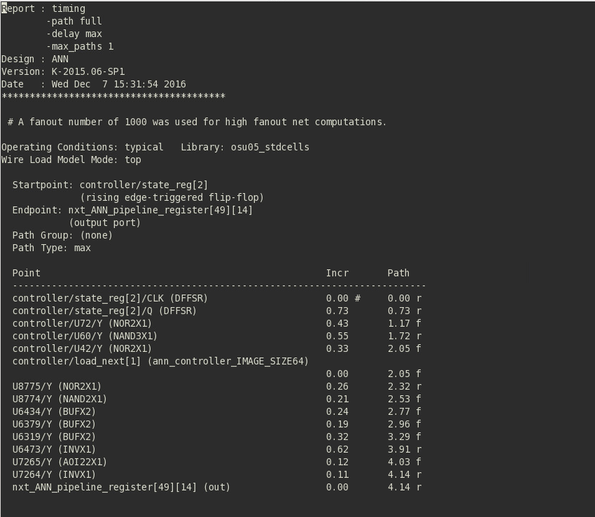
Layout
Critical path delay
Timing budget
estimated
critical path delay
Notes:
Results - Jack

